Slide 1
Annual General Meeting
The Benevolent Fund of the College of Optometrists & Association of Optometrists

Slide 2
2016 Report
Ruth Cuthbert
Chairman of Trustees

Slide 3
Benevolent Fund
Ten Trustees
5 nominated by College
5 by AOP
Quarterly Meetings

Slide 4
Who we helped in 2016
During the year ending September 2016, we supported 13 beneficiaries with regular monthly grants ( 27 in 2015)
6 of working age (14 in 2015)
We helped two other applicants with one-off targeted grants
We helped one beneficiary during a period of injury
We paid AOP fees for seven beneficiaries
We paid GOC fees for four beneficiaries who still practice

Slide 5
Personal debt – a present day problem
We received several new applications during the year 2015-2016 but some were best resolved through personal financial management rather than by grant awards
Fund now offers access to specialist debt management services
We need to strongly recommend critical illness cover, especially for locums

Slide 6
A shift in emphasis
The Trustees are favouring assistance with emergencies and targeted grants rather than payment of long term monthly grants
The intention is to discourage dependency and to help people manage their own financial affairs and optimise their entitlement to state benefits
Cases are reviewed and visited at least annually

Slide 7
Successes 2016
Several of the longer term beneficiaries are now able to support themselves without the help of the Fund.
One practitioner was assisted through a 3-month period of injury but then returned to work and is now supporting her family independently.
Targeted support included car repairs for a practitioner who needed a roadworthy car for work and a new oven for a beneficiary who has limited means.

Slide 8
Who can apply for help?
Members and former members of the College, AOP, and their dependents
Applicants with health problems – short and long term
Aim is to support beneficiaries by helping them remain independent
Support those of working age and aim to help them back to work where possible
Applicants with financial problems

Slide 9
Finance
Secure financial position
Grants to members £63k (£102k 2015)
Subscription based donations from College members, AOP members and donations from individuals £61k (up from £58k 2015)
Administrative & governance costs £15k (up from £12k 2015) Includes cost of new website set-up and secure e-mail
Net assets £1,366k as at 30th September 2016 (up from £1,217k 2015)

Slide 10
Improved governance
A lot of time spent this year improving governance procedures
New business plan, action plan (incl allocation of duties to specific Trustees), lone worker policy (for applicant/beneficiary visits), conflicts of interest management
Registration with Information Commissioner and data protection policy (for handling beneficiary data)
Secure e-mail facility for Trustees
New Rules

Slide 11
Our aims for 2016-2017
Raise awareness through various media so people who need help can find it (new website and OT article already)
Change our Rules and consider incorporation
Keep in touch with our beneficiaries and continue to visit them regularly

Slide 12
Farewell
Ian Shaw - an AOP trustee who retires after many years serving the Ben Fund and who has been Treasurer
Robert Hogan who has served as a Trustee for about 6 years

Slide 13
New Trustee
Welcome to Henry Leonard, AOP Trustee who is an AOP clinical and regulatory advisor.
Welcome to Lisa Gerton, College Trustee who is chair of the GOC Visitor Panel, a member of the SE Wales Regional Optical Committee and a Non Executive Optometric Member of Cardiff’s Local Health Board.

Slide 14
How can you help?
Raise awareness of the Fund
Importance of local Associations
Identify new beneficiaries
Website www.opticalbenfund.com
Visit existing and new beneficiaries
We are grateful for those who make additional donations
Legacies important source of donated funds

Slide 15
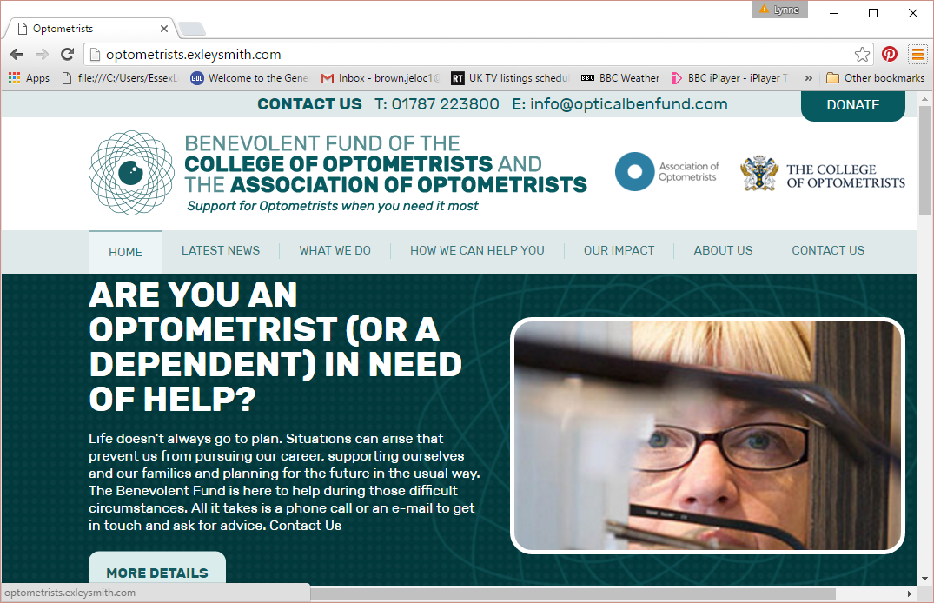
Raising awareness of the Fund

Slide 16
Thanks to
Trustees of the Fund
Members of the professions for donations
Colleagues who visit beneficiaries
Lynne Brown – our Administrative Secretary

