Slide 1
Annual General Meeting
The Benevolent Fund of the College of Optometrists & Association of Optometrists
Year ending 30th September 2017

Slide 2
2017 Report
Ruth Cuthbert
Chairman of Trustees

Slide 3
Benevolent Fund
Ten Trustees
5 nominated by College
5 by AOP
Quarterly Meetings

Slide 4
Who we helped in 2017
During the year ending September 2017, we supported 4 beneficiaries with regular monthly grants (13 in 2016)
3 were of working age (6 in 2016)
2 were awarded cost of living rises
We helped 4 beneficiaries with variable monthly grants, paid by cheque
1 downsized during the year and realised some capital so is now financially independent
We paid for a Dictaphone for a beneficiary who is losing his sight and is studying for a vocational degree
We paid for one beneficiary to have counselling for a range of issues including anxiety and depression

Slide 5
Keeping people in the optometric profession
We paid AOP fees for 7 beneficiaries
We paid GOC fees for 3 beneficiaries who still practice
The College kindly waives its annual fees for many of our beneficiaries

Slide 6
Personal debt – a present day problem
We received 8 new applications during the year 2016-2017. 2 were visited to make a preliminary assessment of their need. Subsequently, not all were awarded grants. Some were helped with professional fees.
One beneficiary was referred to Lloyd and Whyte for informal financial advice.
Four existing beneficiaries were visited in their own homes for reviews. Wherever possible, this is carried out annually.
We need to strongly recommend critical illness cover, especially for locums.

Slide 7
A shift in emphasis
The Trustees are favouring assistance with emergencies, financial advice and targeted grants rather than payment of monthly grants for the long term
The intention is to discourage dependency and to help people manage their own financial affairs whilst optimising their entitlement to state benefits
Cases are reviewed regularly and visited at least annually if possible.

Slide 8
Projects 2017
The website has been improved and is now linked with the AOP Helpline. This is resulting in a greater number of enquiries. The first half of 2017 – 2018 has been busier.
The charity has been working on its governance procedures and new Rules which will improve its working practices and its level of service to beneficiaries.

Slide 9
Who can apply for help?
Members and former members of the College, AOP, and their dependents
Applicants with health problems – short and long term
Aim is to support beneficiaries by helping them remain independent
Support those of working age and aim to help them back to work where possible
Applicants with financial problems

Slide 10
Finance
Secure financial position
Grants paid £39k (£63k 2016)
Subscription based donations from College members, AOP members and donations from individuals £61k (same as 2016)
Investment income - net £44k (£40k in 2016)
Administrative & governance costs £15k (same as 2016)
Funds £1,492k as at 30th September 2017 (up from £1,366k in 2016)

Slide 11
Report and Financial Statement
10 paper copies of the Annual Report and Financial Statement are available for attendees at this meeting
Further copies are available on request. Please give your e-mail address to the Administrative Secretary

Slide 12
Our aims for 2017-2018
Raise awareness through various media so people who need help can find it
Keep in touch with our beneficiaries and continue to visit them regularly
Encourage Critical Illness cover – especially for locums who are the hardest hit when illness strikes
Network with other effective allied medical charities such as Pharmacy Support and learn from their modus operandum
Ensure we are compliant with the new GDPR

Slide 13
Farewell
to Richard Llewellyn - a College Trustee who retires after many years serving the Ben Fund and who will be missed.

Slide 14
New Trustees

Slide 15
How can you help?
Raise awareness of the Fund
Importance of local Associations
Identify new beneficiaries
Website www.opticalbenfund.com
Visit existing and new beneficiaries
We are grateful for those who make additional donations
Legacies important source of donated funds

Slide 16
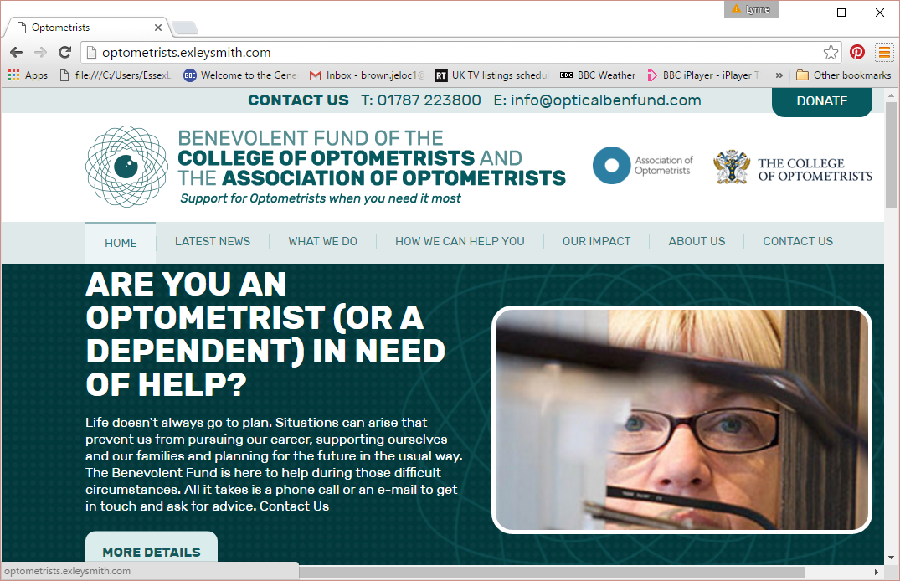
Raising awareness of the Fund

Slide 17
Thanks to
Trustees of the Fund
Members of the professions for donations
Colleagues who visit beneficiaries
Lynne Brown – our Administrative Secretary

